Slide 1


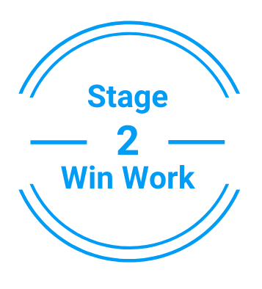

PRESENTATION FOR
ABC CO.
Presented to Jane & John Doe
November 2019
www.clockworkrecruiting.com

Slide 2

Coco Executive Search Today
Coco Executive Search has grown since its inception in 2010.
Core Markets
  Healthcare
  Private Equity
  Education
  Public Service
Clients We Serve
  Portfolio Companies
  Publicly traded companies
Disciplines
  Board of Directors
  C-level positions

Slide 3
Why We Are Different
A Proven Methodology That Drives Superior Results
Through our methodology, we ensure that our clients are engaged in every step of the way to find the right person for their company.
Industry Experts With Over Twenty Years Of Experience
We have assembled a team of industry experts here at Coco with years of experience in their respective fields.
We combine information and strategy to deliver quality results
We believe in providing value in everything we do. With a quality database and reputable placement rate, we let the outcome of our hard work speak for itself.

Slide 4
High Performing Outcomes Guaranteed
Strategic Search Processes Resulting In High Placement Rates
Specialization In Select Fields
Each different kind of search necessitates a different set of skills and experience. Here at Coco we specialize in a select few industries such as Education and Public Services so we can successfully find you the right candidate to hire.
Coco functions on a structured methodology that incorporates advanced software with an eight stage process that results in a quicker search project, more placements, and detailed strategies that provide a guideline for the entire process.

Slide 5
Searches Based On Detailed Search Strategies
Firms composed of people who don’t understand the fundamentals of the larger search process always prove less successful. This is why Coco believes strongly in laying down the foundation in every search and developing search/research strategies from the start.
Collaboration & Transparency
We believe strongly that client collaboration could mean the difference between a failed project and a successful one. This is precisely why we bring our clients on board so that they are able to:
  Play a key role in defining requirements
  Have visibility into targeted activities
  Easily provide needed feedback
  Feel more invested in the search process
What Does Our Search Process Look Like?

Slide 6





Long Standing Partnerships

Slide 7
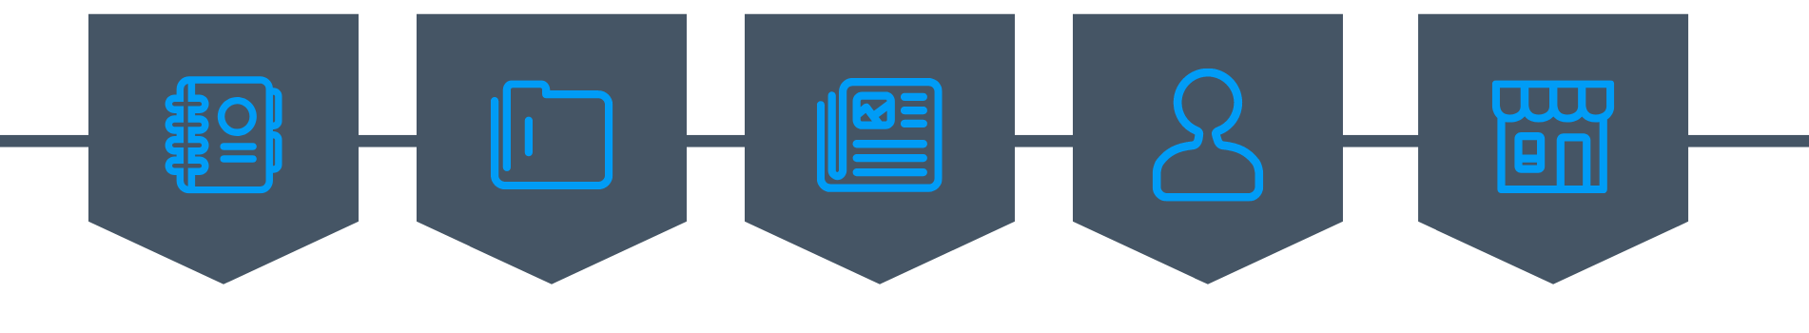
Relevant Experience
CVS HEALTH CORP
Industry: Healthcare
Position: Chief Operating Officer
UNITEDHEALTH GROUP
Industry: Healthcare
Position: Chief Executive Officer
CHEGG
Industry: Education
Position: Chief Financial Officer
CIBC WORLD MARKETS
Industry: Private Equity
Position: Board of Directors
SUPERION
Industry: Public Service
Position: Chief Financial Officer

Slide 8



Eli Desmond
President & Managing Partner
The Coco Executive Team
Lindsey Lillis
Managing Partner
George Waters
Managing Partner

Slide 9

Let Us Do The Searching So You Don’t Have To

